Slide 1

Motors, Sensors, and Samantha
SSI Robotics
September 7, 2013
Capitol College
Notes:
Add topic slide: include that it concentrates on manual operation (i.e. tile-op)

Slide 2
Agenda
Allowed motors and servos
LEGO
MATRIX
TETRIX
Sensors
LEGO
HiTechnic
Samantha
Wiring considerations
How to choose
Motor
Sensor
Notes:
Will this help students transition to C.

Slide 3
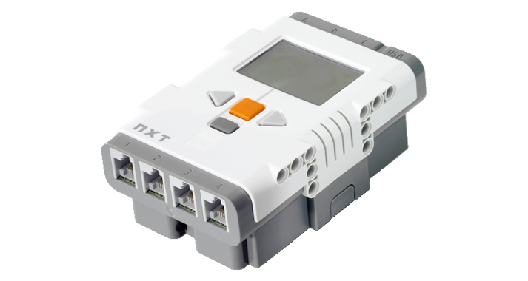
The Intelligent NXT Brick
3 Motor ports
Used for LEGO motors
4 Sensor ports
Used for sensors
Used for TETRIX or MATRIX motor/servo controllers
1 USB port
Used to connect Samantha Wi-Fi module

Slide 4
LEGO Motors
3 ports
Each port can have 1 NXT interactive servo (W979842)
Each port can have 1 XL power function motor (W778882)
Each port can have 2 E power function motors (W979670)
Each port can have 2 M power function motors (W978883)
Each port can have 1 E and 1 M motor

Slide 5
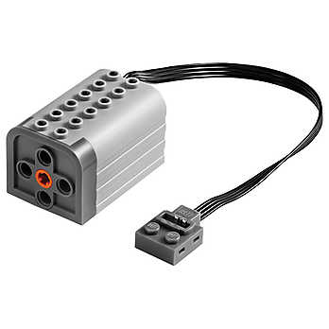

LEGO Motors
E Motor
9V DC
Torque 4.5 Ncm
800 RPM (no load)
M Motor
9V DC
Torque 11 Ncm
400 RPM (no load)
Specifications from www.philohome.com web site

Slide 6

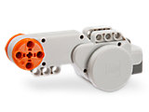
LEGO Motors
XL Motor
9V DC
Torque 40 Ncm
220 RPM (no load)
Interactive Servo Motor
9V DC
Torque 50 Ncm
170 RPM (no load)
Specifications from www.philohome.com web site

Slide 7
MATRIX and TETRIX Motors
Can use either MATRIX or TETRIX motors – NOT BOTH
Any number of controllers allowed (limited by NXT hardware and software)
Maximum of 8 TETRIX or MATRIX DC motors
Maximum of 12 Servos

Slide 8
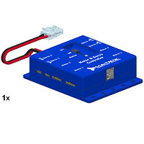
MATRIX Controllers
Each controller uses 1 sensor port
4 servos per controller
AND
4 motors per controller

Slide 9
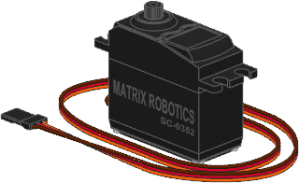
MATRIX Servos
Speed 0.14s/60 degrees
Stall torque 6.5 kg-cm
Stall current 1500mA
Operating Travel 120 degrees
Specifications from MATRIXrobotics.com web site.

Slide 10
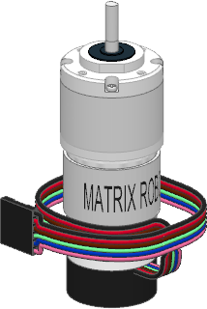
MATRIX Motors
Standard and High Torque
9V DC with encoder
196-265 rpm no load
Stall Torque 5.75 kg-cm (S) 16.8 kg-cm (HT)
Stall Current 4200 mA (S) 5800 mA (HT)
Encoder provides 757.12 ticks per revolution
Specifications from MATRIXrobotics.com web site.

Slide 11


TETRIX Controllers
Each controller uses 1 sensor port
Can daisy chain 4 controllers on one sensor port
6 independent servo ports per controller
Can use “Y” cables to have 2 servos on one port
2 motor ports per controller
Can use 2 motors on 1 port
1 encoder port per motor port

Slide 12


TETRIX Motors
One size
12V DC with optional encoder
152 rpm no load
300 oz-in of torque
Optional encoder provides 1440 ticks per revolution

Slide 13
TETRIX Servos
Many options
4 models available from parts.ftcrobots.com
2 standard
1 “normal” 180 degrees, 89 oz-in torque (6.4 kg-cm)
1 continuous rotation 52 RPM, 46.8 oz-in (3.37 kg-cm)
2 quarter-scale
1 “normal” 180 degrees, 183 oz-in torque (13.2 kg-cm)
1 1260 degree rotation, 183 oz-in torque (12.2 kg-cm)
Any standard size or smaller servo with a rated stall current of 800 mA or less
No more than 2 quarter-scale servos per controller with at most one other standard servo
If only 1 quarter-scale servo on the controller then up to 4 standard servos may be used

Slide 14
Sensors
TETRIX/MATRIX/LEGO
Motor Encoder
LEGO
Color Sensor
Touch
Ultrasonic
Sound
Light

Slide 15
Sensors
HiTechnic
Accelerometer
Angle
Color V2
Compass
EOPD
Force
Gyro
IR Seeker V2
Magnetic
PIR
Touch Mux
Sensor Mux
SuperPro Prototype Board

Slide 16
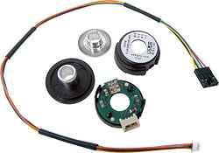
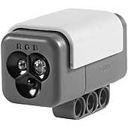
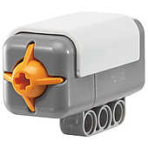
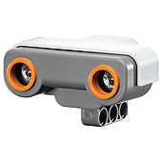
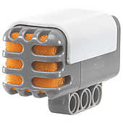
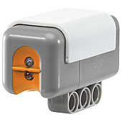
Sensors
Motor encoders
Can be used to count motor rotations
LEGO Color sensor
Used to check color of an object
LEGO Touch sensor
Used to detect something touching the sensor
LEGO Ultrasonic sensor
Used to measure distance to an object
LEGO Sound sensor
Used to measure ambient sound level
LEGO Light sensor
Used to measure light level
Useful for line detection/following

Slide 17




Sensors
HiTechnic Accelerometer sensor
Can be used to measure acceleration and tilt in 3-axes
HiTechnic Angle sensor
Used to measure absolute angle, accumulated angle or rotational speed
HiTechnic Color sensor V2
Used to measure the color of an object in front of the sensor
HiTechnic Compass sensor
Used to measure magnetic heading of the sensor
HiTechnic EOPD sensor
Electro Optical Proximity Detector
Used to accurately measure distance (up to 8”)

Slide 18



Sensors
HiTechnic Force sensor
Used to measure how hard something is pushing on the sensor
HiTechnic Gyro sensor
Can be used to measure angular rotation
HiTechnic IR Seeker V2
Used to detect either a constant or modulated IR signal
HiTechnic Magnetic sensor
Used to detect a magnetic field in front of the sensor
HiTechnic PIR sensor
Passive Infrared
Used to detect people or animals moving in front of the sensor

Slide 19
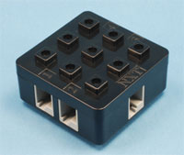
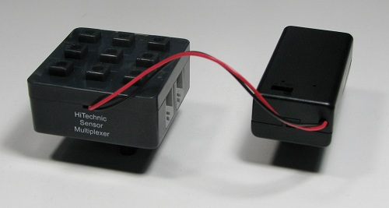
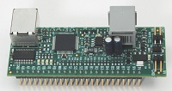
Sensors
HiTechnic Touch sensor multiplexer
Allows 4 standard touch sensors to be plugged into one sensor port
HiTechnic Sensor multiplexor
Allows 4 NXT or HiTechnic sensors to be plugged into one sensor port
HiTechnic SuperPro Prototyping board
Allows any sensor to be integrated to the NXT provided it is powered by the board
Processor on the board may not be re-programmed

Slide 20
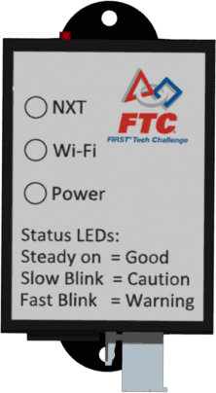
Samantha
Provides communication to the field
Mount high on robot with lights visible
Make sure cables can NOT come loose during a match (either end)
Use HIGH quality USB cable routed away from other wires
Add Ferrite chokes to USB cable if necessary to reduce ESD problems

Slide 21
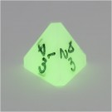

How do you choose motors and sensors?
Roll a die?
Flip a coin?

Slide 22
How do you choose motors and sensors?
Motors
How much room do you have?
Physical space
Available control ports
LEGO motor
TETRIX/MATRIX motor
Servo
Weight budget / stability issues
Do you need full rotation ability or is limited ok?
How much torque do you need?

Slide 23
How do you choose motors and sensors?
Sensors
What are you trying to determine?
How many sensor ports do you have left?

